Slide 1
Spring Data JPA & Mappings

Slide 2
Contents
History of JPA
Spring ORM
JPA
Spring Data JPA
Association Mappings

Slide 3
History of JPA
JDBC
JDBC Template
Hibernate

Slide 4
Spring ORM
ORM is a technique for converting data between Java objects and relational databases (table). In simple words, we can say that the ORM implements responsibility of mapping the object to relational model and vice-versa. the ORM tool does mapping in such a way that model class becomes a table in the database and each instance becomes a row of the table.

Slide 5
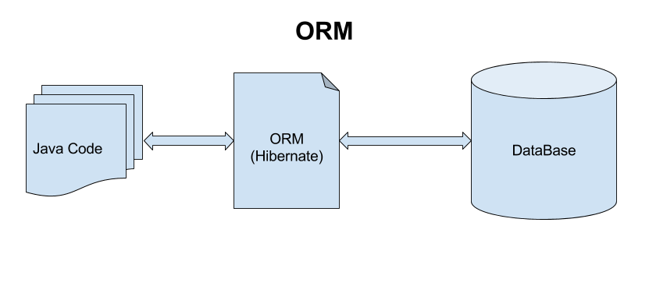

Slide 6
JPA
Java has created a specification called Java Persistent API. It aims towards bringing consistency around accessing different databases.
Entity Manager Factory
Entity Manger
Transcation Management

Slide 7
Spring Data JPA
Spring Boot JPA is a Java specification for managing relational data in Java applications. It allows us to access and persist data between Java object/ class and relational database. JPA follows Object-Relation Mapping (ORM).
JPA is not a framework. It defines a concept that can be implemented by any framework.

Slide 8
Association Mappings
Spring JPA table relationships using SpringBoot and PostgreSQL database.
One-to-One Mapping
One-to-Many Mapping
Many-to-One Mapping
Many-to-Many Mapping

Slide 9
Usage of Mappings
Prevents Redundant data
Saves Memory
Maintain Relationships

Slide 10
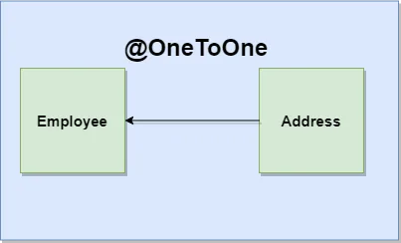
One-to-One Mapping
The One-To-One mapping represents a single-valued association where an instance of one entity is associated with an instance of another entity. In this type of association one instance of source entity can be mapped at most one instance of target entity.

Slide 11
One-to-Many Mapping & Many-to-One Mapping
Many-To-One mapping represents a single-valued association where a collection of entities can be associated with the similar entity. Hence, in relational database any more than one row of an entity can refer to the similar rows of another entity.
One-To-Many mapping comes into the category of collection-valued association where an entity is associated with a collection of other entities. Hence, in this type of association the instance of one entity can be mapped with any number of instances of another entity.

Slide 12
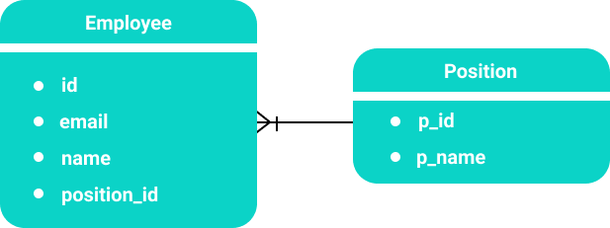

Slide 13
Many-to-Many Mapping
The Many-To-Many mapping represents a collection-valued association where any number of entities can be associated with a collection of other entities. In relational database any number of rows of one entity can be referred to any number of rows of another entity.

Slide 14
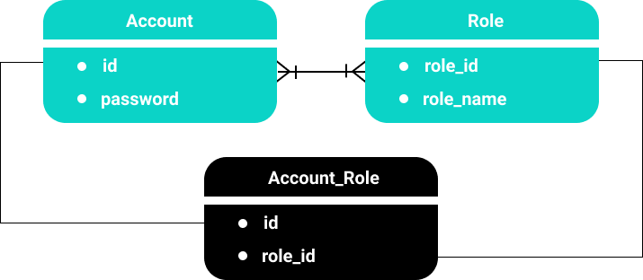

Slide 15
Thank you

